Slide 1
Physiomodel 1.0
www.physiomodel.org
www.physiolibrary.org

Slide 2
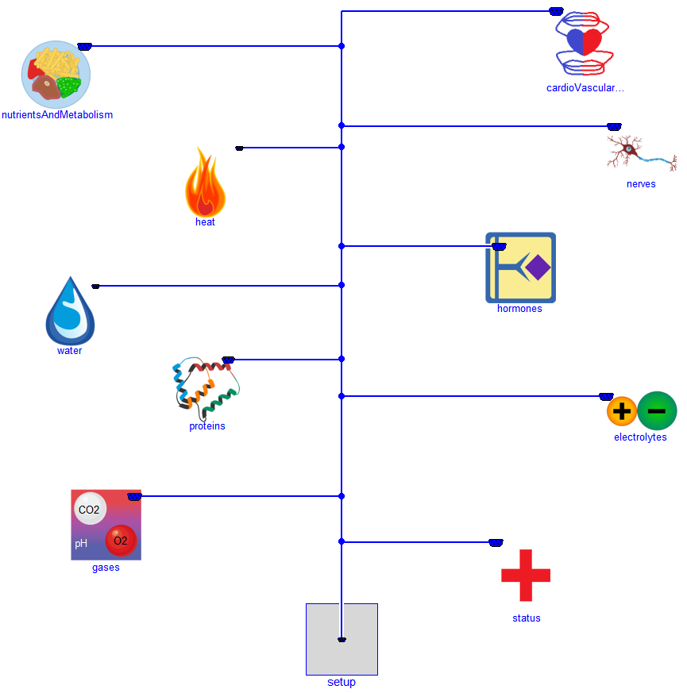
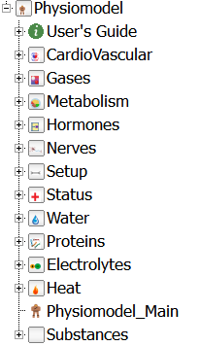
Physiomodel Structure

Slide 3
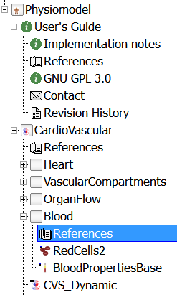
References
class References "References"
extends Modelica.Icons.References;
annotation (Documentation(info="<html>
<table>
<tr>
<td>[Begg1966]</td>
<td>T. Begg and J. Hearns, \"Components in blood viscosity. The relative contribution of haematocrit, plasma fibrinogen and other proteins,\" Clinical science, vol. 31, pp. 87-93, 1966. </td>
</tr>
</table>
</html>"));
end References;

Slide 4

Expandable connector
expandable connector BusConnector
"Empty control bus that is adapted to the signals connected to it"
annotation (Documentation(info="<html>
<p>
This connector defines the \"expandable connector\" that is used
as bus in the Physiomodel.
Note, this connector is \"empty\". When using it, the actual content is
constructed by the signals connected to this bus.
</p>
</html>"));
end BusConnector;

Slide 5
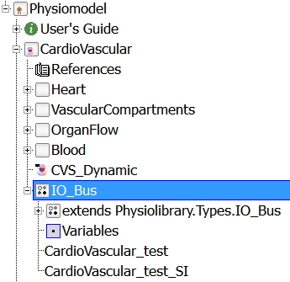
Input-Output Bus
package IO_Bus
extends Physiolibrary.Types.IO_Bus;
redeclare model extends Variables
T.Volume ArtysVol(varName="ArtysVol.Vol")
"Volume of oxygenated blood in body.";
T.Fraction BloodVol_Hct(varName="BloodVol.Hct")
"Heamatocrit = red cells / blood.";
…
equation
connect(ArtysVol.y, busConnector.ArtysVol);
connect(BloodVol_Hct.y, busConnector.BloodVol_Hct);
…
end Variables;

Slide 6
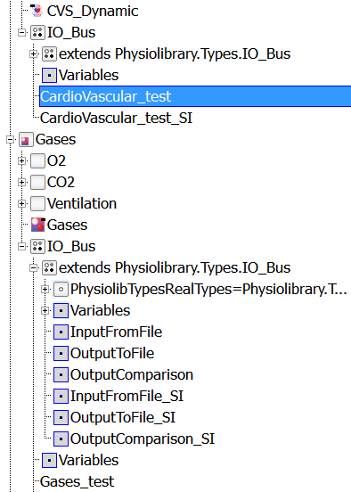
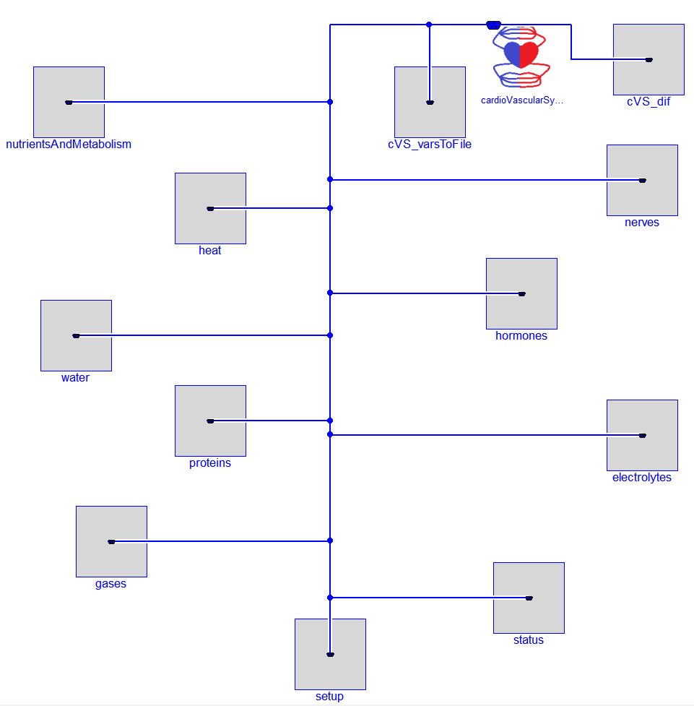
IO_Bus usage

Slide 7
Thank you for your attention!
www.physiomodel.org
www.physiolibrary.org

